Slide 1
Trainity project 2
Name : ROHAN LAKKAMPALLI
EMAIL: lakkampallirohan@gmail.com

Slide 2
TOOLS USED
SQL WORKBENCH 8.0 CE

Slide 3
A) MARKETING ANALYSIS

Slide 4
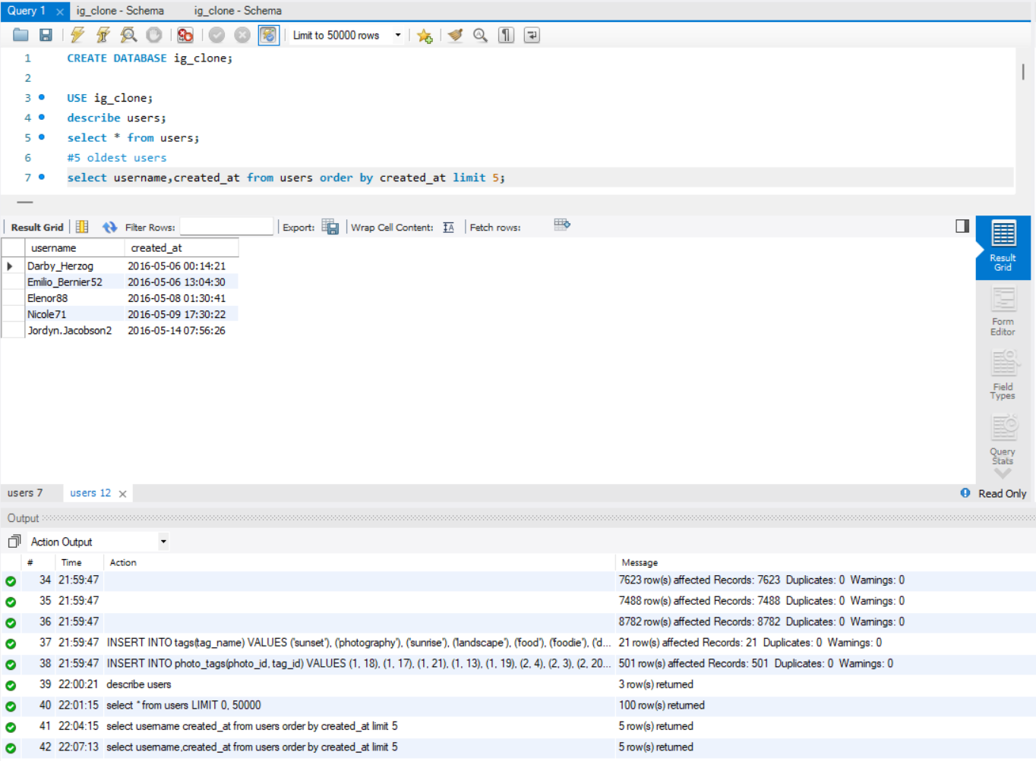
Task 1
#Loyal User Reward: The marketing team wants to reward the most loyal users, i.e., those who have been using the platform for the longest time. Your Task: Identify the five oldest users on Instagram from the provided database.

Slide 5
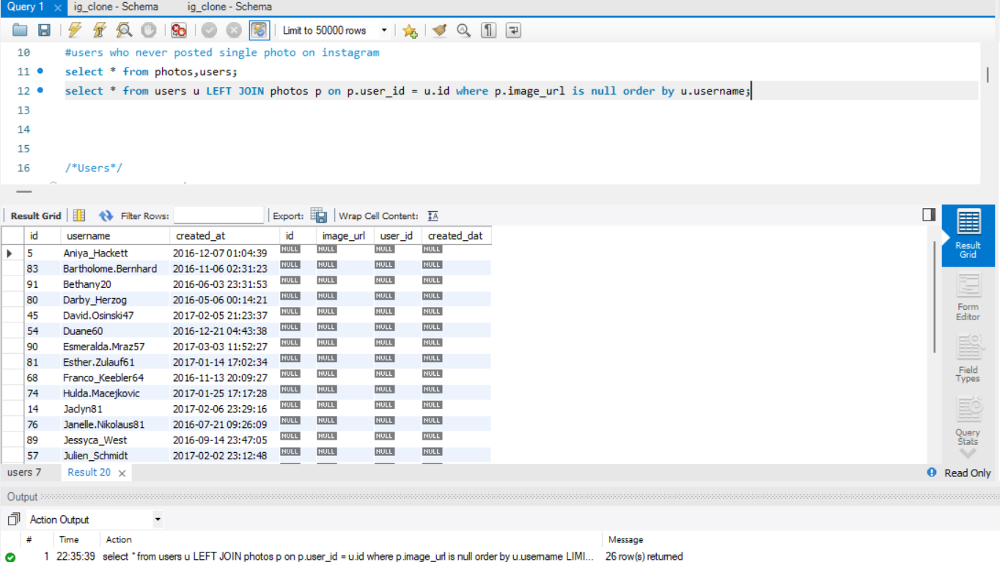
Loyal User Reward: The marketing team wants to reward the most loyal users, i.e., those who have been using the platform for the longest time. Your Task: Identify the five oldest users on Instagram from the provided database.

Slide 6
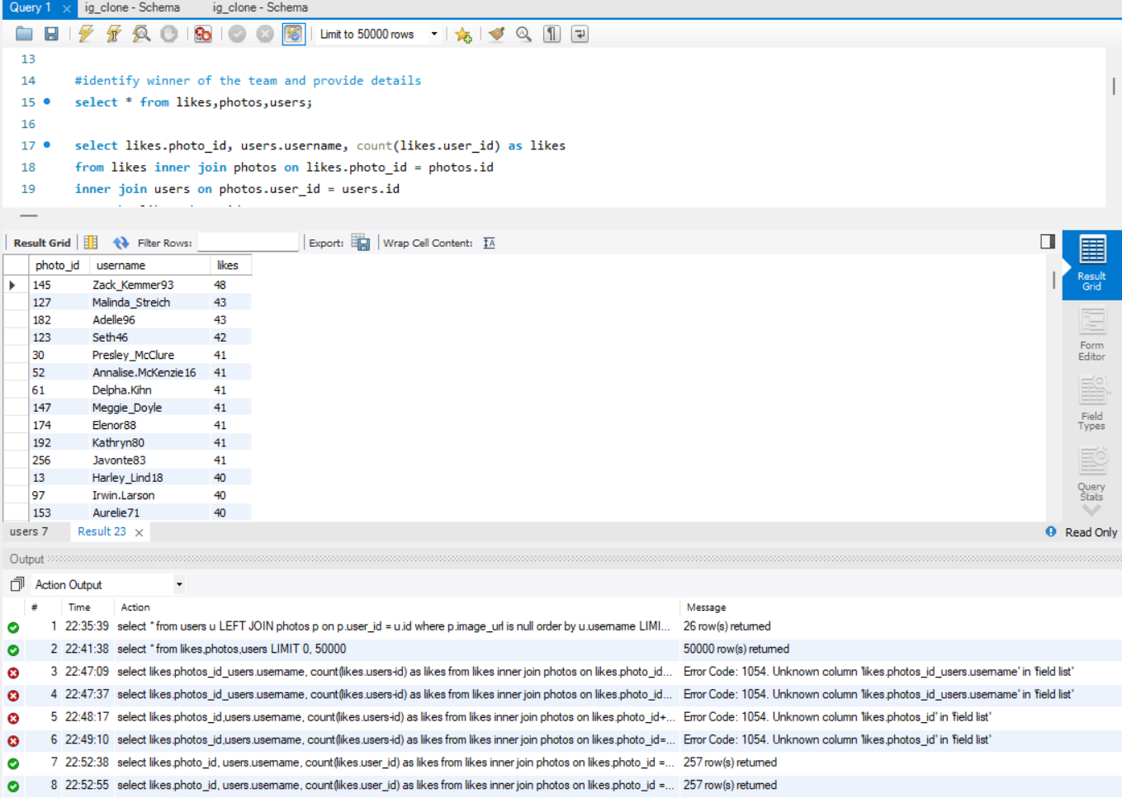
Contest Winner Declaration: The team has organized a contest where the user with the most likes on a single photo wins. Your Task: Determine the winner of the contest and provide their details to the team.

Slide 7
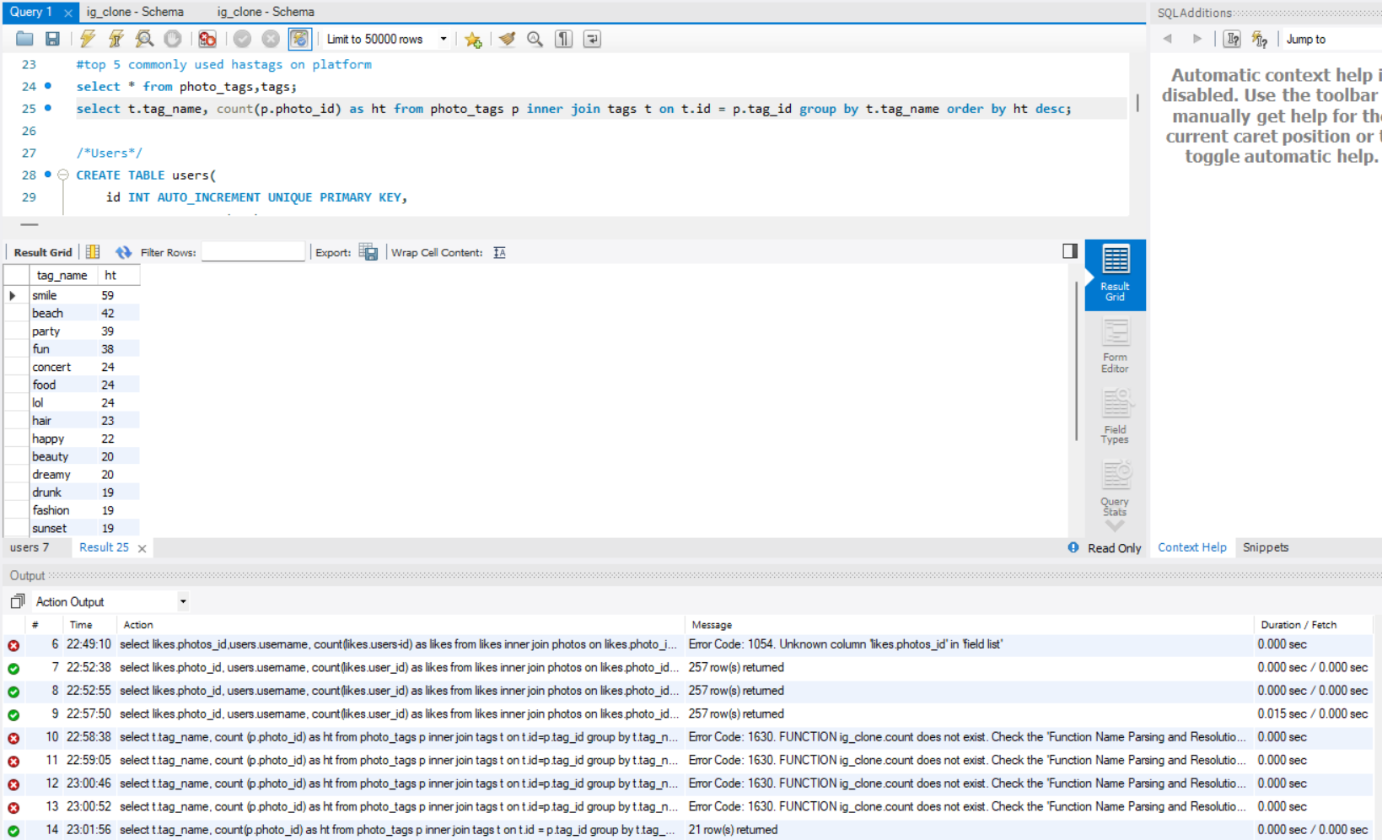
Hashtag Research: A partner brand wants to know the most popular hashtags to use in their posts to reach the most people. Your Task: Identify and suggest the top five most commonly used hashtags on the platform.

Slide 8
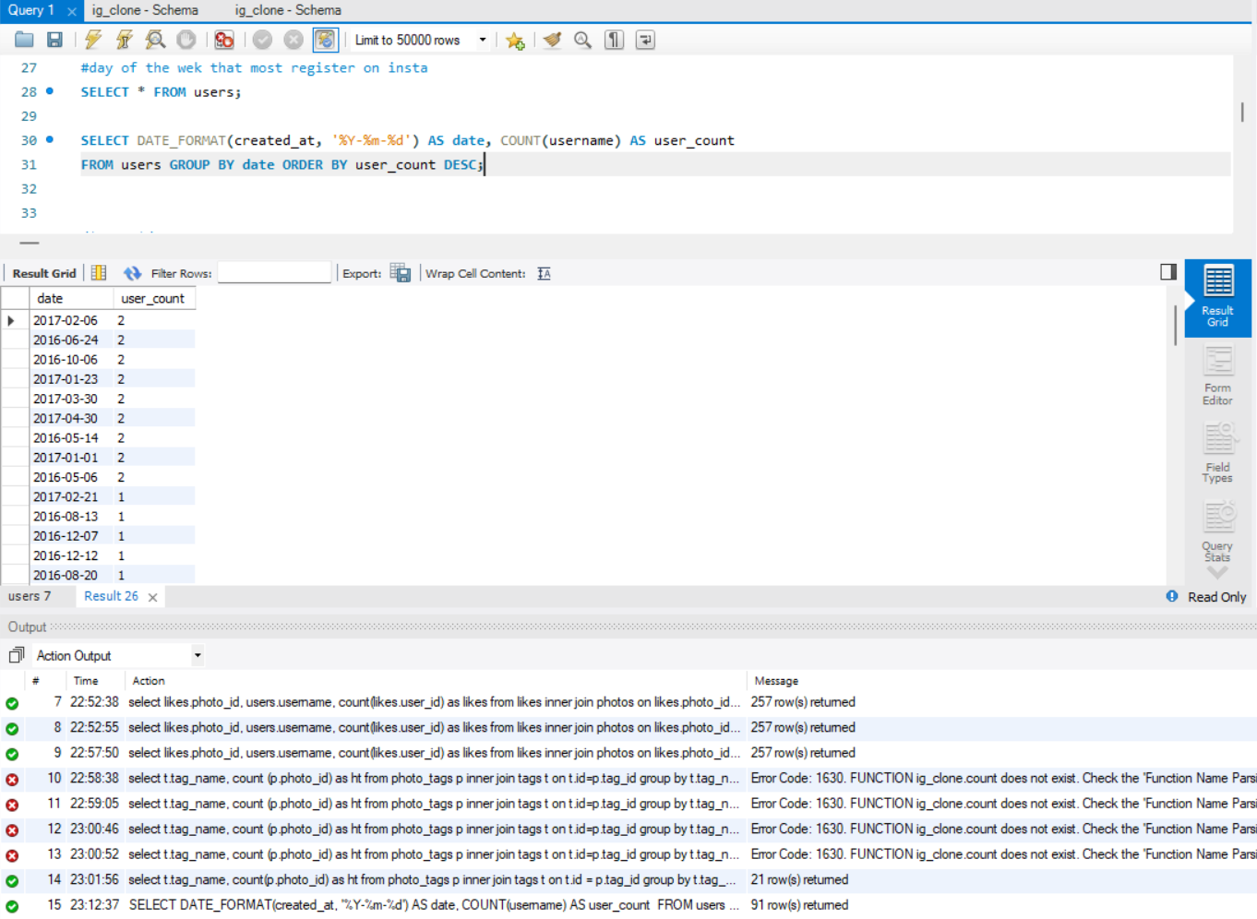
Ad Campaign Launch: The team wants to know the best day of the week to launch ads. Your Task: Determine the day of the week when most users register on Instagram. Provide insights on when to schedule an ad campaign.

Slide 9
B) INVESTOR METRICS

Slide 10
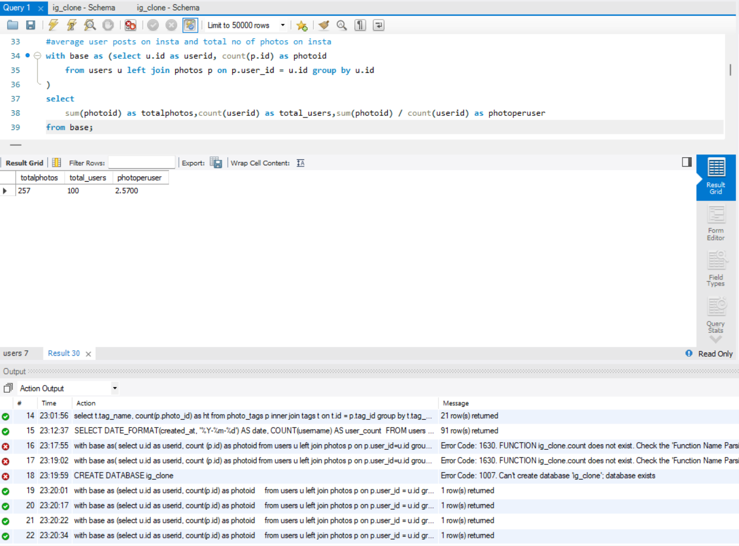
User Engagement: Investors want to know if users are still active and posting on Instagram or if they are making fewer posts. Your Task: Calculate the average number of posts per user on Instagram. Also, provide the total number of photos on Instagram divided by the total number of users.

Slide 11
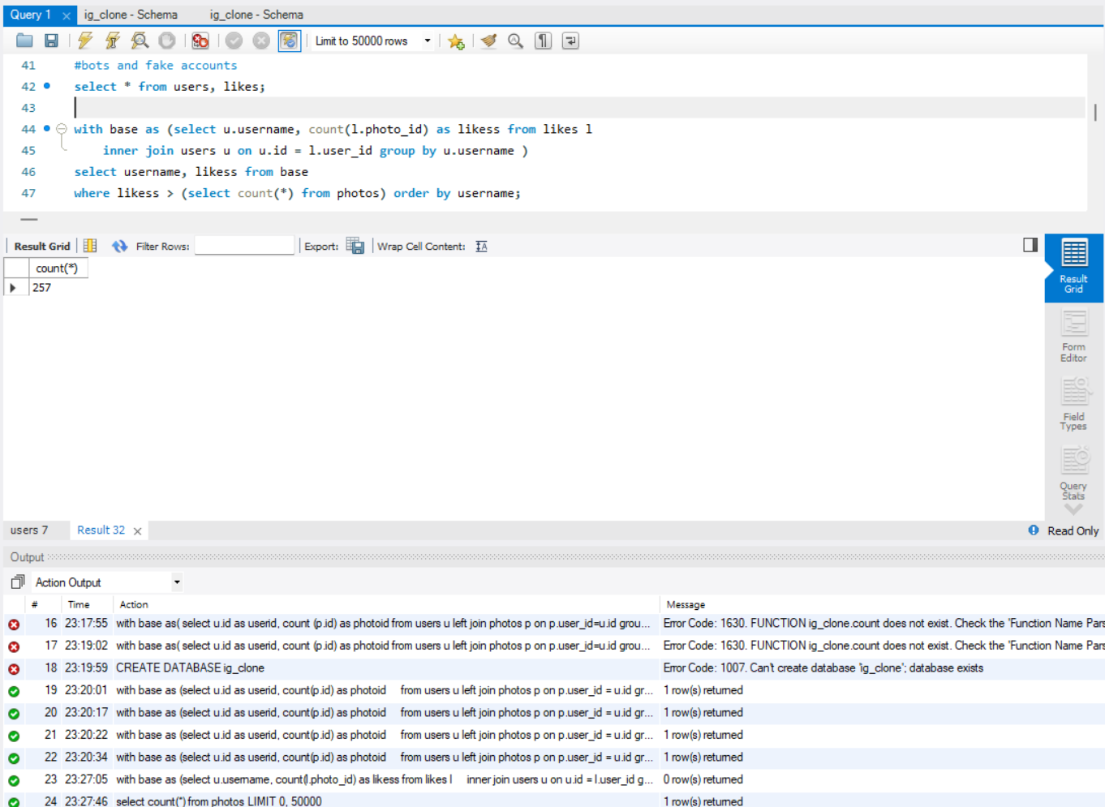
Bots & Fake Accounts: Investors want to know if the platform is crowded with fake and dummy accounts. Your Task: Identify users (potential bots) who have liked every single photo on the site, as this is not typically possible for a normal user.

Slide 12
Insights
The loyal users (oldest users) can be a potential target for retention campaigns.
Inactive users may benefit from targeted email campaigns to encourage engagement.
The winner of the contest can be used for promotional purposes.
The most popular hashtags can help brands maximize visibility.
The best day for ad campaigns will provide a strategic advantage for marketing teams.

Slide 13
RESULTS:
This analysis provides valuable insights into user engagement, marketing strategies, and potential issues with bot accounts, benefiting the product and marketing teams as they plan future developments and campaigns. It also offers a clearer picture of user behavior on Instagram, supporting the platform's growth and user retention efforts.

